Slide 1

Design and Implementation of a Door Security Alarm System Using BJT Switching
Electronic Devices and Design Lab - EE-CE 208
Name | ID
Abdullah Shebairm | 10081271
Yousef AlAbdulrazzaq | 75018
Fahad Mutlaq Alazmi | 10085539
Spring 2026

Slide 2
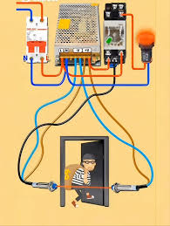
Introduction
Modern security systems require reliable and fast detection mechanisms to prevent unauthorized access.
This project presents a door alarm system that detects the opening of a door and immediately activates an alert.
The system converts a mechanical action (door movement) into an electrical response, ensuring real-time monitoring and enhanced safety.

Slide 3
Aim and Objectives
Aim:
To design and implement a door alarm system using discrete electronic components.
Overview:
Detect door opening using a magnetic sensor
Activate an audible and visual alert
Ensure stable operation at Vdc​=11.96V
Demonstrate transistor switching behavior
Validate performance using simulation and hardware implementation

Slide 4
Criteria and Constraints
Design Criteria:
The system must detect door opening accurately
The alarm (buzzer and LED) must activate immediately
The circuit must operate reliably under all conditions
Transistors must switch correctly between cutoff and saturation
The design should ensure stable and continuous operation
Design Constraints:
Use only the specified components provided in the lab kit
Operate at assigned supply voltage: 11.96 V
Implementation must be on a breadboard
Limited to given resistor values (1 kΩ, 2.2 kΩ, 330 Ω)
The circuit must remain simple and energy-efficient

Slide 5
Components Specifications
Component | Value / Type | Function
Transistor Q1 | BC547 (NPN) | Controls the switching behavior of Q2
Transistor Q2 | SL100 (NPN) | Acts as a power switch to drive the buzzer and LED
Resistor R1 | 1 kΩ | Limits base current of Q1
Resistor R2 | 2.2 kΩ | Provides base bias for Q1 (pull-up)
Resistor R3 | 330 Ω | Limits current through the LED
Reed Switch | Magnetic sensor | Detects door position (open/close)
Buzzer | — | Produces audible alarm
LED | — | Provides visual indication
Diode D1 | 1N4007 | Protects circuit from reverse voltage
DC Power Supply | 11.96 V | Provides required operating voltage

Slide 6
Project Description and Applications
Project Description
The system is designed to monitor the state of a door using a magnetic reed switch. When the door is closed, the magnet keeps the reed switch open, and the alarm remains OFF. When the door is opened, the magnet moves away, the reed switch closes, activating the alarm. This behavior ensures immediate detection of unauthorized access.
Applications
Residential security systems for doors and windows Office and commercial building access monitoring Storage rooms and restricted areas protection Basic intrusion detection systems Integration into smart home security solutions

Slide 7
Proposed Solution and Design Evaluation
How it works
When the reed switch is closed, base current flows into Q1, driving Q1 into saturation. This results in a low collector voltage at Q1, turning Q2 OFF, alarm is OFF. When the reed switch is open, Q1 enters cutoff. The base of Q2 has drive, so Q2 turns ON, activating the alarm.
Result
When switch is closed → buzzer and LED OFF (alarm OFF)
When switch is open → buzzer and LED ON (alarm ON)

Slide 8
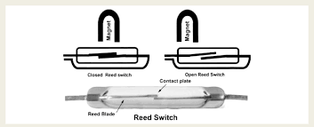
Magnetic Reed Switch
A reed switch consists of two ferromagnetic contacts enclosed in a glass tube.
Presence of a magnetic field → contacts close
Absence of magnetic field → contacts open
This allows the device to function as a non-contact sensor, making it suitable for security systems.

Slide 9
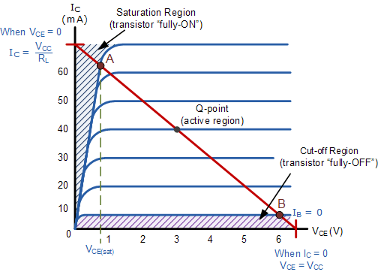
BJT Transistor Fundamentals
A BJT operates in three regions:
Cutoff: No current flow (OFF state)
Active: Amplification region
Saturation: Maximum conduction (ON state)
In this design:
Transistors operate between cutoff and saturation
This ensures efficient switching and reliable load control

Slide 10
Control System Concept
The circuit behaves as a two-stage control system:
The input (reed switch) determines the state of Q1
Q1 controls the voltage applied to Q2
Q2 drives the output devices (buzzer and LED)
This sequential control ensures that the output responds directly to changes in the input condition.

Slide 11
Block Diagram
Door / Magnetic Field
Reed Switch (Sensor)
Signal Control (Q2)
Power Driver (Q1)
Output (Buzzer + LED)

Slide 12
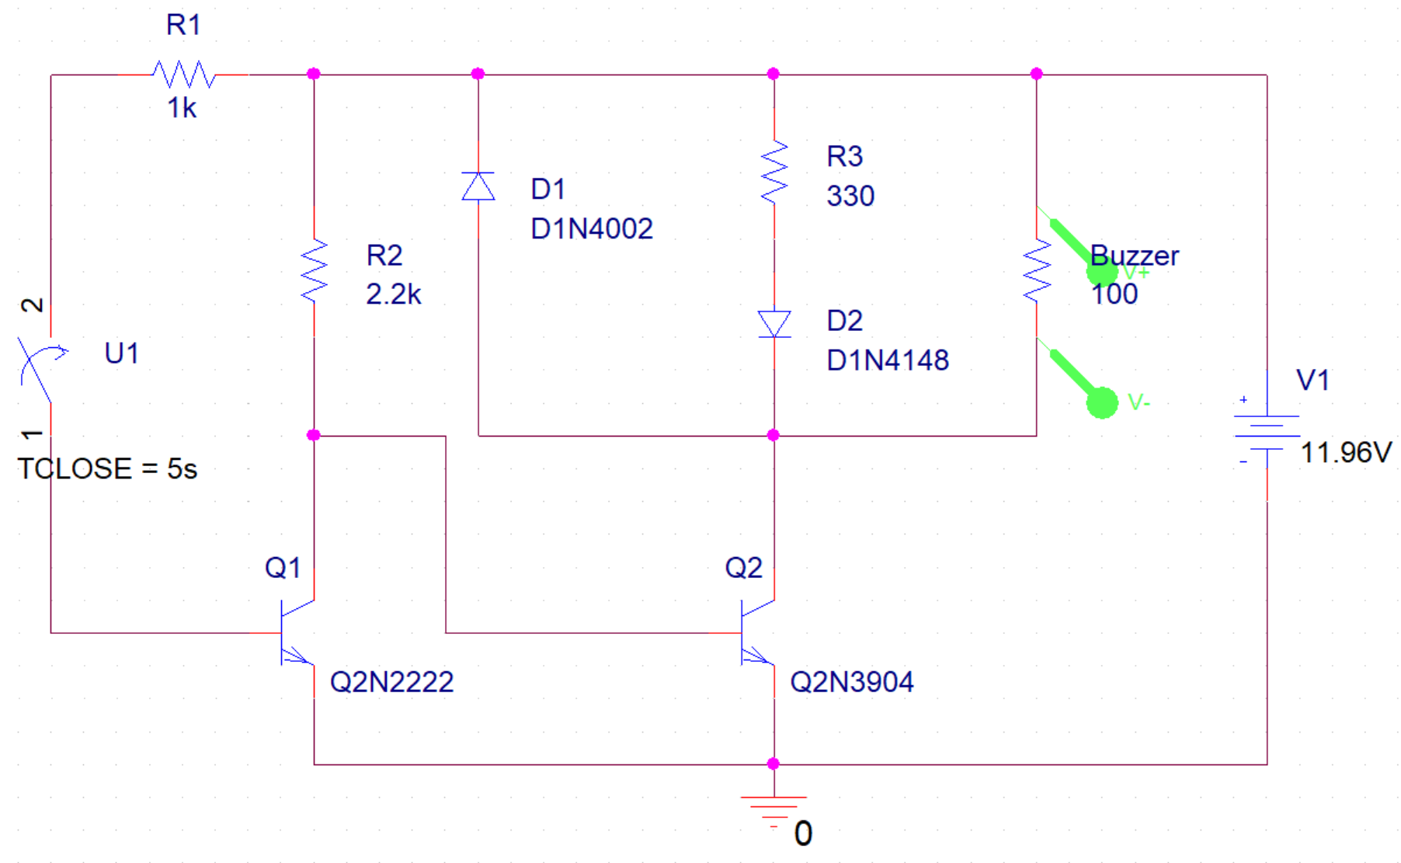
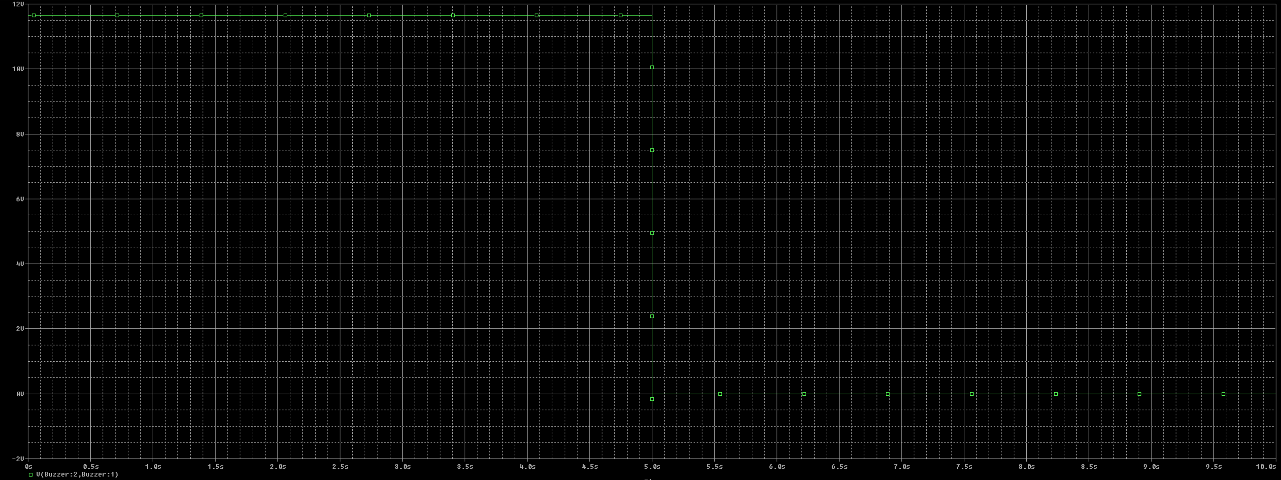
Simulation (OrCAD)

Slide 13

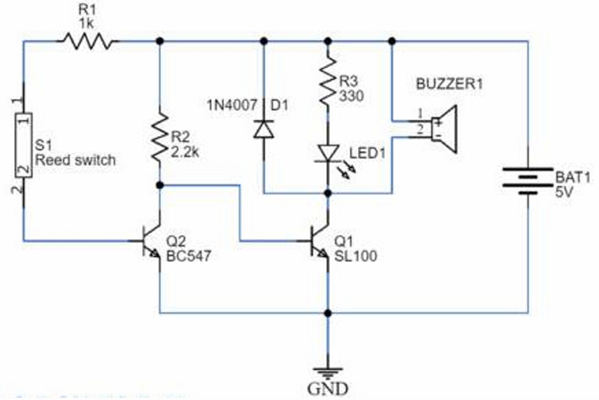
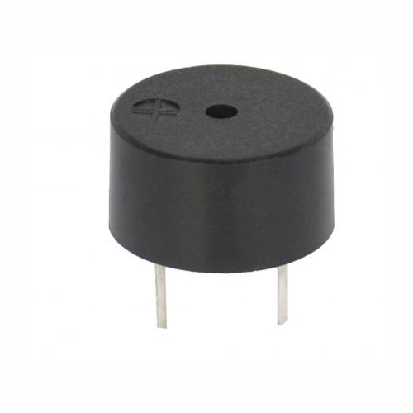
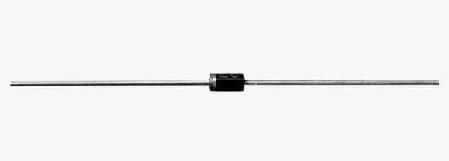
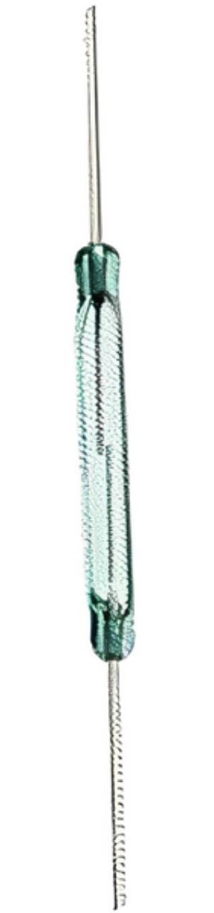
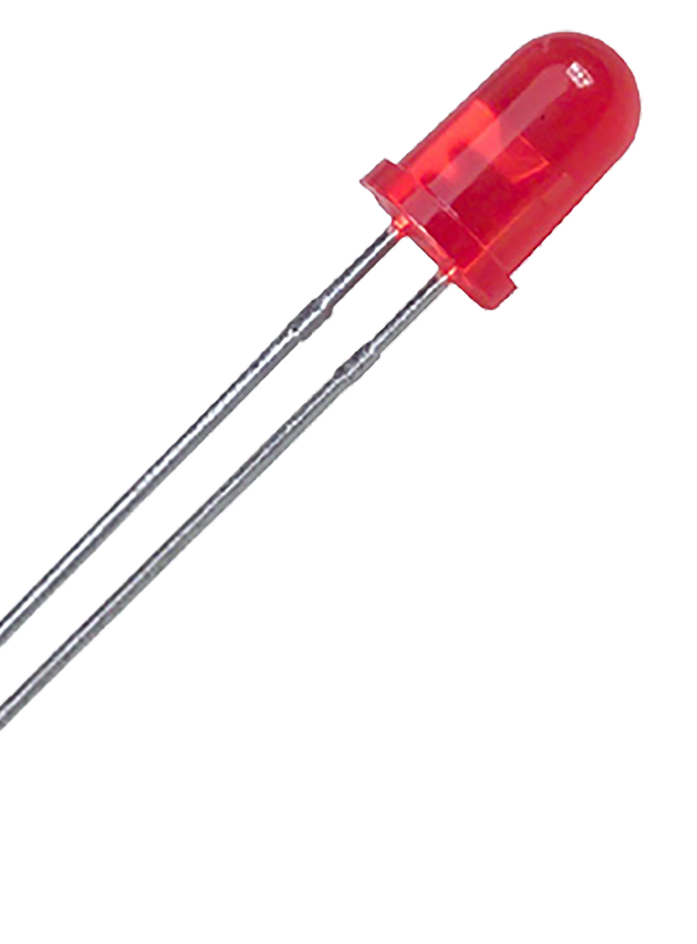

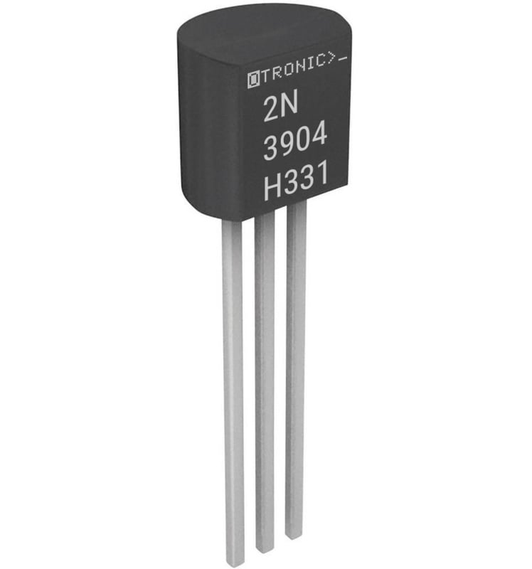
Prototype Explanation
11.96V

Slide 14
Problems and Difficulties
Ensuring correct transistor biasing
Maintaining stable operation at 11.96 V
Finding replacements for components missing from Pspice simulation libraries
Verifying correct switching behavior during testing

Slide 15
Conclusion
The designed door alarm system successfully detects door opening and activates an alert.
The circuit demonstrates:
Reliable switching using BJTs
Effective use of a magnetic sensor
Stable performance under assigned conditions
This project highlights the practical application of electronic devices in security systems.

Slide 16
References
Eswitch, “What is a Magnetic Reed Switch and How Does it Work? - E-Switch,” E-Switch, Feb. 13, 2026. https://www.e-switch.com/news-events/blog/switches-simplified/what-is-a-magnetic-reed-switch/
https://www.onsemi.com/download/data-sheet/pdf/bc547-d.pdf
Vishay General Semiconductor, “General Purpose Plastic Rectifier,” technical report Document Number: 88503, Mar. 2020. [Online]. Available: https://www.vishay.com/docs/88503/1n4007.pdf

